Slide 1
處理器設計與實作
CPU LAB for Computer Organization

Slide 2
LAB 6
Verilog Implementation Of I-Cache

Slide 3
實驗目的
認識MIPS CPU的Memory Hierarchy
學習Verilog module之應用
了解I-Cache的架構與行為

Slide 4
Levels of Memory Hierarchy
Upper Level
(Faster)
CPU
Registers
Cache
Main Memory (DRAM)
Secondary Storage (Hard Disk)
Lower Level
(larger)

Slide 5
The Principle of Locality
Temporal Locality (Locality in Time):
If an item is referenced, it will tend to be referenced again
soon.
( Example: loop, reuse )
Spatial Locality (Locality in space):
If an item is referenced, items whose addresses are close
by tend to be referenced soon.
( Example: array access, straight line code )

Slide 6
Introduction to Cache System
Insert between CPU and Main Memory
Implemented with fast Static Ram
Holds some of a program’s
Data (D-Cache)
Instructions (I-Cache)
CPU
Processor
data
addr.
Cache Memory
(K Bytes)
data
addr.
Main Memory
(G Bytes)

Slide 7
Cache Operation
CPU sends an address to Cache
Hit : Data in Cache (no penalty)
Miss: Data not in Cache
(miss penalty)
CPU
Processor
Cache Hit
data
addr.
Cache Memory
(K Bytes)
data
addr.
Main Memory
(G Bytes)

Slide 8
Cache Operation
CPU sends an address to Cache
Hit : Data in Cache (no penalty)
Miss: Data not in Cache
(miss penalty)
CPU
Processor
Cache Hit
data
addr.
Cache Memory
(K Bytes)
data
addr.
Main Memory
(G Bytes)

Slide 9
Cache Operation
CPU sends an address to Cache
Hit : Data in Cache (no penalty)
Miss: Data not in Cache
(miss penalty)
CPU
Processor
data
addr.
Cache Miss !
Cache Memory
(K Bytes)
data
addr.
Main Memory
(G Bytes)

Slide 10
Cache Operation
CPU send an address to Cache
Hit : Data in Cache (no penalty)
Miss: Data not in Cache
(miss penalty)
CPU
Processor
data
addr.
Cache Miss !
Cache Memory
(K Bytes)
data
addr.
Main Memory
(G Bytes)

Slide 11
Cache Operation
CPU sends an address to Cache
Hit : Data in Cache (no penalty)
Miss: Data not in Cache
(miss penalty)
CPU
Processor
data
addr.
Cache Miss !
Cache Memory
(K Bytes)
Delay
data
addr.
Main Memory
(G Bytes)

Slide 12
Cache Performance
Hit Rate: Fraction of hits in Cache
Miss Rate = 1 – (Hit Rate)
Hit Time: Time to access Cache
Miss Penalty: Time to replace a block from lower level
Average memory-access time ( AMAT )
= Hit Time + Miss rate x Miss penalty

Slide 13
Direct Mapped Block Placement
00
04
08
0c
Index
0
1
2
3
10
Data
14
*0
18
*4
1c
*8
20
*c
24
28
2c
30
34
38
3c
Cache
Main Memory

Slide 14
Direct Mapped Example
The sequence of memory access: 00, 04, 08, 0c, 10
Memory Block | Hit/Miss
Index
0
4
8
c
Cache

Slide 15
Direct Mapped Example
The sequence of memory access: 00, 04, 08, 0c, 10
Memory Block | Hit/Miss
00 | Miss
Index
0
4
8
c
Cache

Slide 16
Direct Mapped Example
The sequence of memory access: 00, 04, 08, 0c, 10
Memory Block | Hit/Miss
00 | Miss
Index
From main memory
0
Mem[00]
4
8
c
Cache

Slide 17
Direct Mapped Example
The sequence of memory access: 00, 04, 08, 0c, 10
Memory Block | Hit/Miss
00 | Miss
04 | Miss
Index
0
Mem[00]
4
8
c
Cache

Slide 18
Direct Mapped Example
The sequence of memory access: 00, 04, 08, 0c, 10
Memory Block | Hit/Miss
00 | Miss
04 | Miss
Index
0
Mem[00]
Mem[04]
From main memory
4
8
c
Cache

Slide 19
Direct Mapped Example
The sequence of memory access: 00, 04, 08, 0c, 10
Memory Block | Hit/Miss
00 | Miss
04 | Miss
08 | Miss
Index
0
Mem[00]
Mem[04]
Mem[08]
4
From main memory
8
c
Cache

Slide 20
Direct Mapped Example
The sequence of memory access: 00, 04, 08, 0c, 10
Memory Block | Hit/Miss
00 | Miss
04 | Miss
08 | Miss
0c | Miss
Index
0
Mem[00]
Mem[04]
Mem[08]
Mem[0c]
4
8
From main memory
c
Cache

Slide 21
Direct Mapped Example
The sequence of memory access: 00, 04, 08, 0c, 10
Memory Block | Hit/Miss
00 | Miss
04 | Miss
08 | Miss
0c | Miss
10 | Miss
Index
From main memory
0
Mem[10]
Mem[04]
Mem[08]
Mem[0c]
4
8
c
Cache

Slide 22
Cache Line Refill Load in multi-data when cache miss

Slide 23
Cache Line Refill : 16-byte line size
00
04
08
0c
index
10
14
0*
1*
2*
3*
00
04
08
0c
18
10
14
18
1c
1c
20
24
28
2c
20
30
34
38
3c
24
28
2c
30
34
38
3c
Cache
Main Memory

Slide 24
Line Refill Example: 16-byte line size
The sequence of memory access: 00, 04, 08, 0c, 10
Mem Block | Hit/Miss
Index
0*
1*
2*
3*
Cache

Slide 25
Line Refill Example: 16-byte line size
The sequence of memory access: 00, 04, 08, 0c, 10
Mem Block | Hit/Miss
00 | Miss
Index
0*
1*
2*
3*
Cache

Slide 26
Line Refill Example: 16-byte line size
The sequence of memory access: 00, 04, 08, 0c, 10
Mem Block | Hit/Miss
00 | Miss
Index
0*
Mem[00]
Mem[04]
Mem[08]
Mem[0c]
1*
2*
3*
Cache
From main memory

Slide 27
Line Refill Example: 16-byte line size
The sequence of memory access: 00, 04, 08, 0c, 10 (word address)
Mem Block (Word) | Hit/Miss
00 | Miss
04 | Hit
Index
0*
Mem[00]
Mem[04]
Mem[08]
Mem[0c]
1*
2*
3*
Cache

Slide 28
Line Refill Example: 16-byte line size
The sequence of memory access: 00, 04, 08, 0c, 10
Mem Block | Hit/Miss
00 | Miss
04 | Hit
08 | Hit
Index
0*
Mem[00]
Mem[04]
Mem[08]
Mem[0c]
1*
2*
3*
Cache

Slide 29
Line Refill Example: 16-byte line size
The sequence of memory access: 00, 04, 08, 0c, 10
Mem Block | Hit/Miss
00 | Miss
04 | Hit
08 | Hit
0c | Hit
Index
0*
Mem[00]
Mem[04]
Mem[08]
Mem[10]
1*
2*
3*
Cache

Slide 30
Line Refill Example: 16-byte line size
The sequence of memory access: 00, 04, 08, 0c, 10
Line size = 16 bytes
Mem Block | Hit/Miss
00 | Miss
04 | Hit
08 | Hit
0c | Hit
10 | Miss
Index
0*
Mem[00]
Mem[04]
Mem[08]
Mem[0c]
1*
2*
3*
Cache

Slide 31
Line Refill Example: 16-byte line size
The sequence of memory access: 00, 04, 08, 0c, 10
Mem Block | Hit/Miss
00 | Miss
04 | Hit
08 | Hit
0c | Hit
10 | Miss
Index
0*
Mem[00]
Mem[10]
Mem[04]
Mem[14]
Mem[08]
Mem[18]
Mem[0c]
Mem[1c]
1*
2*
3*
Cache
From main memory

Slide 32
Address (aligned to a word for instruction)
Block Address (32-bit)
Tag | Index | word | 00
Index : Decide which entry of cache should be accessed
Tag : Check if the cache access is a hit or not
Word : Decide which data of entry to output
How do we decide number of bits in each part?

Slide 33
Cache Architecture
This is a Cache with 8 entries, and each line (entry) has 4 words (data).
3-bit [6:4]
2-bit [3:2]
Address [31:0]
Tag
Index
Word
0000 0000 0000 0000 0000 0000 0 | 100 | 10 | 00
31 7 6 4 3 2 1 0
32-3-2-2=25-bit [31:7]
2-bit [1:0]
Index
Valid
Data
Tag
Word=0
Word=1
Word=2
Word=3
000
1 | 0008… | 0x00001c0 | 0x00001c4 | 0x00001c8 | 0x00001cc
0
0
1 | 00c0… | 0x0024000 | 0x0024004 | 0x0024008 | 0x002400c
1 | 0000… | 0x1c00000 | 0x1x00004 | 0x1c00008 | 0x1c0000c
0
0
0
001
010
011
100
101
110
111

Slide 34
Cache Architecture
If a Cache with 256 entries, and each line (entry) has 4 words (data) …
Address [31:0]
Tag
Index
Word
0000 0000 0000 0000 0000 | 0000 0010 | 10 | 00
31 12 11 4 3 2 1 0
2-bit [3:2]
32-8-2-2=20-bit [31:12]
8-bit [11:4]
2-bit [1:0]
Index
Valid
Tag
Word=0
Word=1
Word=2
Word=3
0000 0000
1 | 0008… | 0x00001c0 | 0x00001c4 | 0x00001c8 | 0x00001cc
0
0
1 | 00c0… | 0x0024000 | 0x0024004 | 0x0024008 | 0x002400c
1 | 0000… | 0x1c00000 | 0x1x00004 | 0x1c00008 | 0x1c0000c
0
0
0
0000 0001
.
.
.
.
.
.
1111 1111

Slide 35
Cache Architecture
Address
Index
Word
Tag
0x0000 | 100 | 10 | 00
Data Output =
0x1c00008
Data
Index
Valid
Tag
Word=00
Word=01
Word=10
Word=11
000
1 | 0x0008 | 0x00001c0 | 0x00001c4 | 0x00001c8 | 0x00001cc
0
0
1 | 0x00c0 | 0x0024000 | 0x0024004 | 0x0024008 | 0x002400c
1 | 0x0000 | 0x1c00000 | 0x1x00004 | 0x1c00008 | 0x1c0000c
0
0
0
001
010
011
100
101
110
111
tag_in
tag_out
=
Hit = 1 ( Cache Hit )
(tag_in = tag_out) & valid_out =1

Slide 36
LAB 6
Verilog Implementation Of I-Cache

Slide 37
Tool used
實驗環境:
Modelsim (Run CPU simulator)

Slide 38
Modelsim 安裝
1. Modelsim PE overview
http://model.com/content/modelsim-pe-simulation-and-debug
2. Modelsim PE download
http://model.com/update/modelsim-downloads

Slide 39
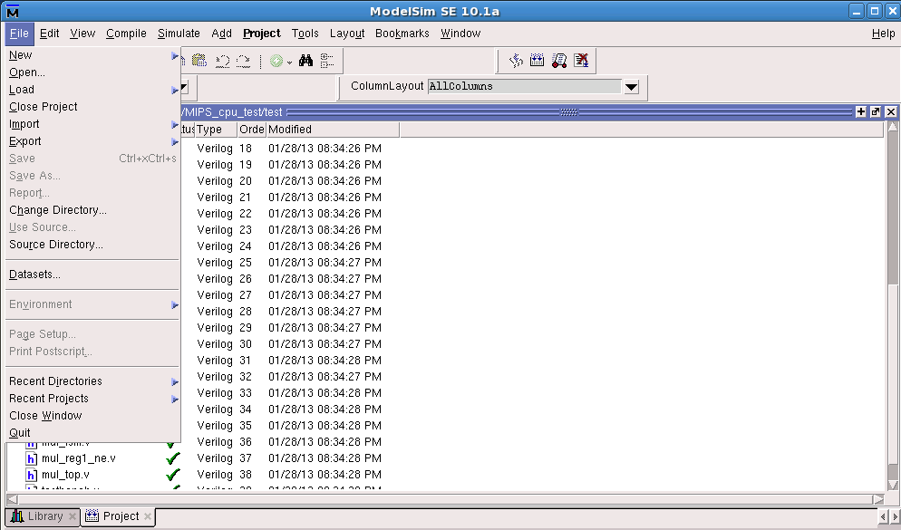
Modelsim 開啟教學(1/3)
Step.1:change to our file location
打開modelsim後,在File下選擇change directory到你放\...\MIPS_cpu_test 的地方

Slide 40
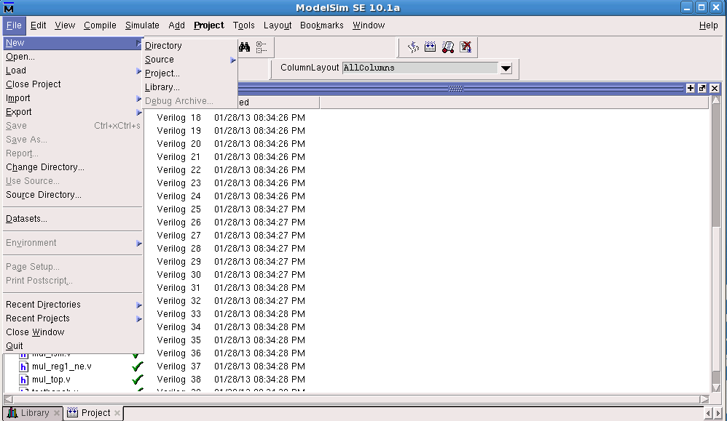
Modelsim 開啟教學(2/3)
Step.2:new project
接著new一個project(名稱自訂)

Slide 41
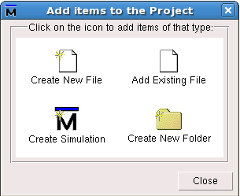
Modelsim 開啟教學(3/3)
Step.3:add source code
新增完project後,會跳出一個視窗(如圖),點選Add Existing File將VHDL/Verilog source code加入到這個project中

Slide 42
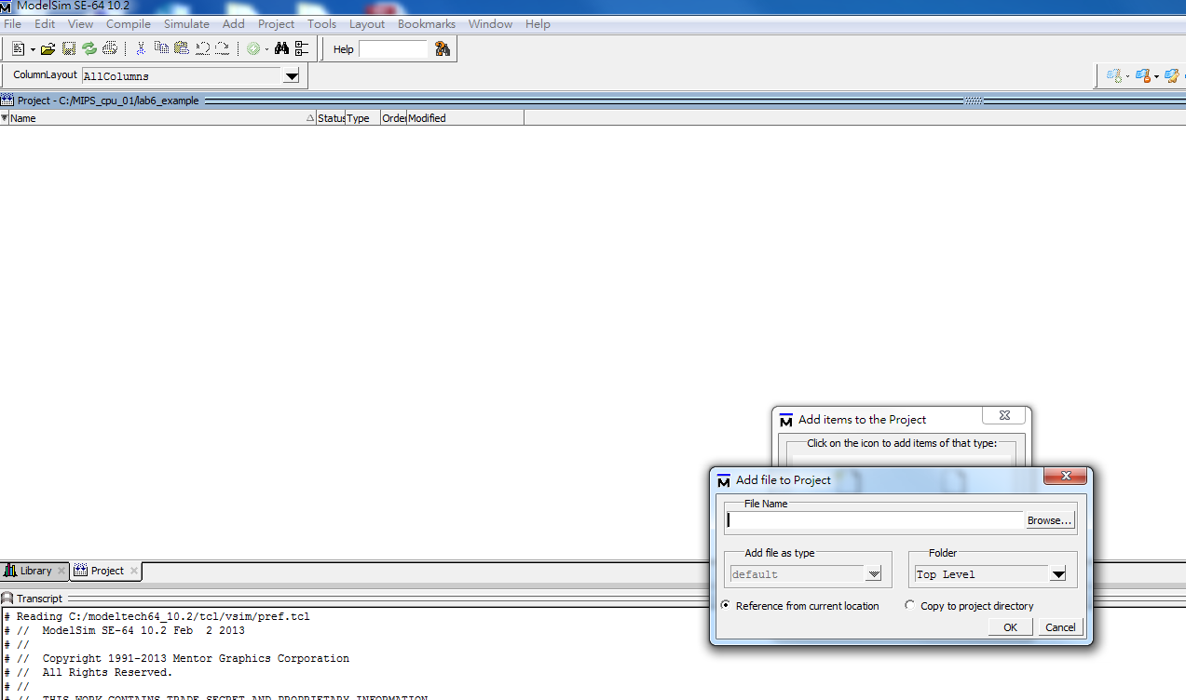
Modelsim 驗證(1/4)
點選browse，把所有的.v檔加進來

Slide 43
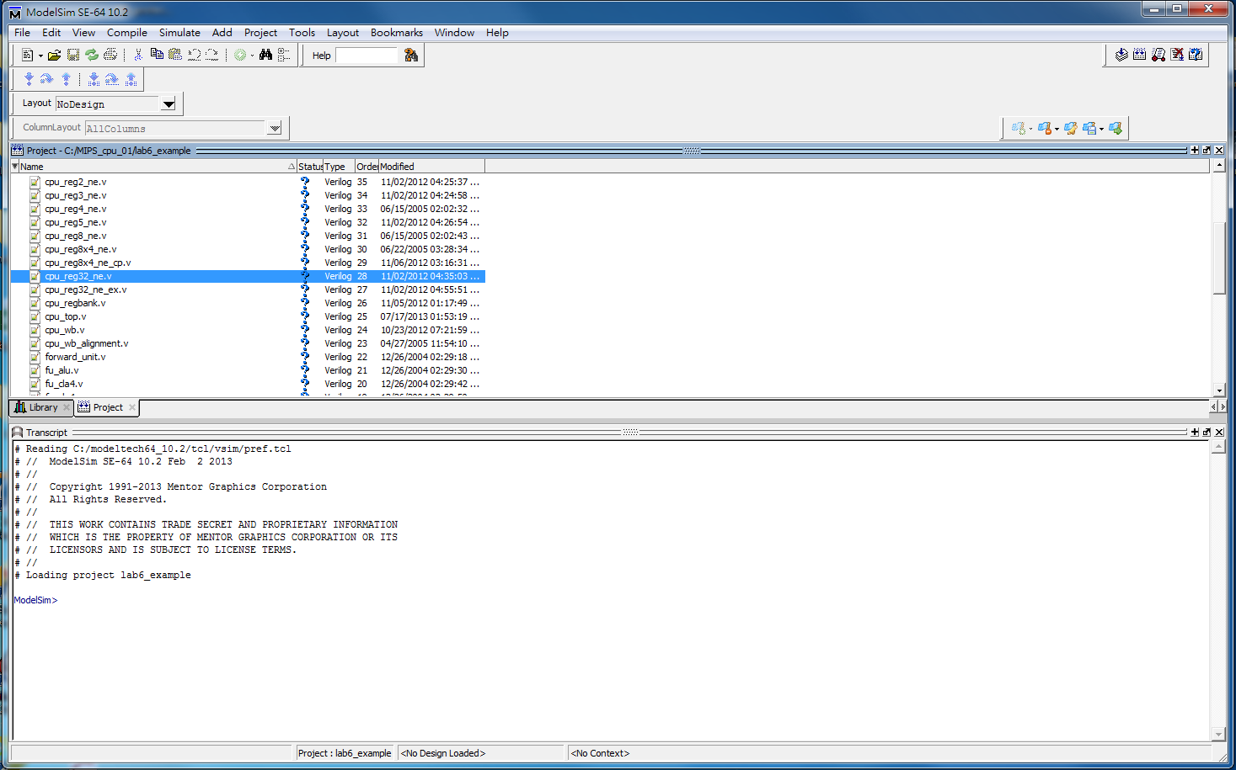
Modelsim 驗證(2/4)
Compile source code
新增完 source code 之後，點選右上角的compile (實作時如果有修改程式碼，只要從compile之後重新做即可)

Slide 44
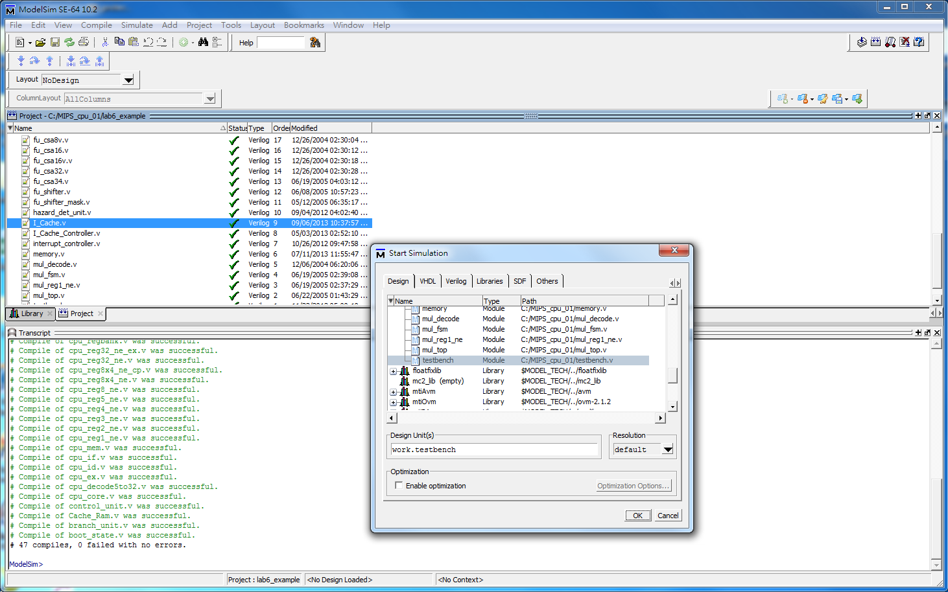
Modelsim 驗證(3/4)
Simulate testbench
Compile 之後，點選右上角的 simulate ，選 testbench，計得要把enable optimization 取消

Slide 45
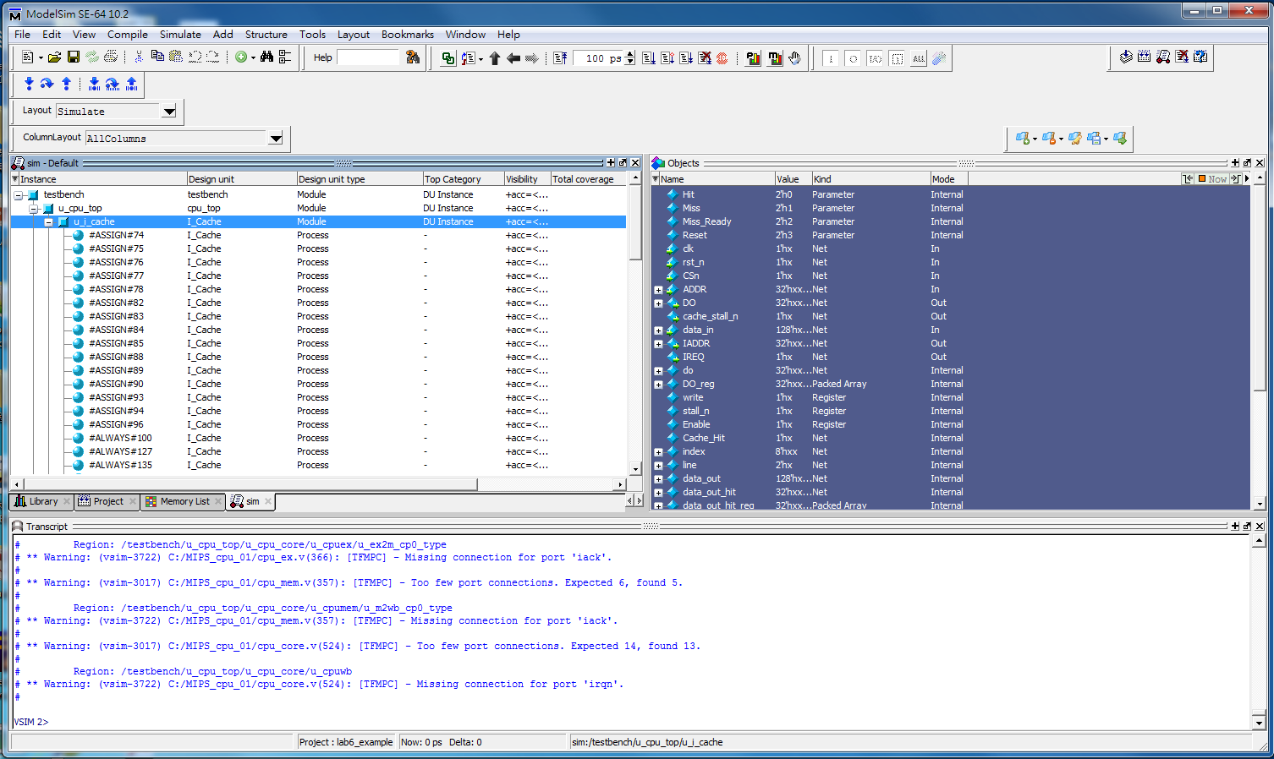
Modelsim 驗證(4/4)
打開testbench -> u_cpu_top -> u_icache 把右邊所有 input output訊號線加到波形，就可以驗證波形是否正確

Slide 46
實作一
請同學以RTL code完成這顆MIPS CPU中I_Cache.v空白部分,使用ModelSim編譯完成,並且完成驗證。
Direct Mapped I-Cache :
There are 256 entries in this cache
Each entry (line) with exactly 1 word (data)

Slide 47
Cache Architecture
Address
Tag
Index
0x0000 | 4 (100) | 00
Valid
Tag
Data
0
1 | 0x0008 | 0x00001c24
0
0
1 | 0x00c0 | 0x00004c00
1 | 0x0000 | 0x00c10800
0
0
0
1
2
3
4
Data_Out
5
6
7
valid_out
tag_out
tag_in
=
Hit = 1 ( Cache Hit )
(tag_in = tag_out) & valid_out =1

Slide 48
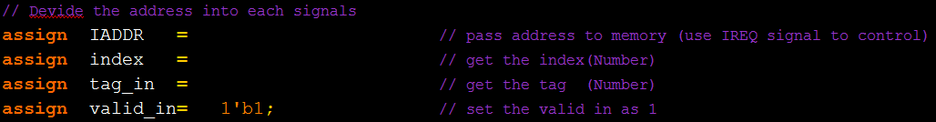
Part 1
This is a “Direct Mapped I-Cache” with 256 entries each having a 32- bit data.
ADDR [31:0] is a 32-bit signal (address) from CPU to Cache
First, you have to pass the ADDR to IADDR (send addr. to memory if cache miss)
The cache has 256 entries which means that your index should be ___ bits.
Once you know how many bits for index and tag_in, get index & tag_in from ADDR
31
0
tag_in
index
00
請同學根據前面的內容決定 index, tag_in 分別需要幾個 bit，並且寫出二個訊號
分別來自ADDR當中的哪一段

Slide 49
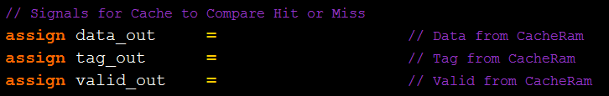
Part 2
In part2, we have to prepare data_out, tag_out and valid_out signals.
And, we need the signal “index” which we have prepared in part1 to help us.
Use index to get data_out from cache memory
Use index to get tag_out from cache memory
Use index to get valid_out from cache memory
256 entries
Cache_Valid
Cache_Tag
Cache_Data
請同學根據前面的提示決定 data_out, tag_out 和 valid_out

Slide 50
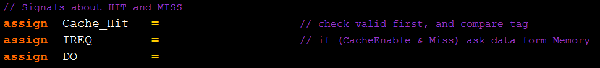
Part 3
Now that you have most of the signals you need, you have to decide if the cache access is a hit or not. And send the correct signals to memory and CPU.
For Cache_Hit signal, check if valid_out=1, then compare tag_in and tag_out
For IREQ signal, make sure that Enable=1 first, and check if Cache_Hit = 1 or 0
For DO signal, use output_enable to decide out data (DO_reg or 32’bz)
IREQ is a signal to request data from main memory
Enable is a signal which indicates if the cache is enabled or not.
DO (Data Out) is the data from cache to CPU
output_enable is a signal indicating if the output data are ready or not
DO_reg is a register which contains the data for output
請同學根據前面的說明，完成Cache_Hit, IREQ, DO

Slide 51
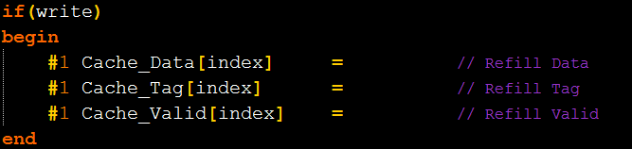
Part 4
When a cache_miss happened, you have to update the data in I-Cache including Cache_Data, Cache_Tag and Cache_Valid .
Put the new data called “Data_in” into Cache_Data
Put the new tag called “tag_in” into Cache_Tag
Put the new data called “valid_in” into Cache_Valid
Data_in is a 32-bit data from main memory
Tag_in is the new tag which you got from part1
Valid_in is just a signal 1 which indicates that the cache line is valid.
請同學根據前面的內容在Cache發生miss的時候更新Cache的內容

Slide 52
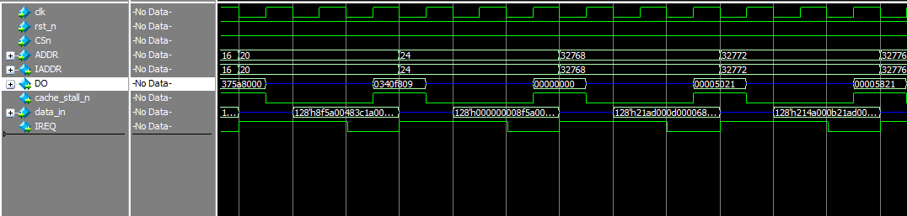
Verification
If your RTL code is correct, you will find that the cache will miss whenever the address changes

Slide 53
實作二
請同學以RTL code完成這顆MIPS CPU中I_Cache.v空白部分,使用ModelSim編譯完成,並且完成驗證。
This is a “Direct Mapped I-Cache”
There are 256 entries in this cache
Each entry (line) has 4 words (data).

Slide 54
Cache Architecture
Address
Index
Word
Tag
0x0000 | 100 | 10 | 00
Data Output =
0x1c00008
Data
Index
Valid
Tag
Word=00
Word=01
Word=10
Word=11
000
1 | 0x0008 | 0x00001c0 | 0x00001c4 | 0x00001c8 | 0x00001cc
0
0
1 | 0x00c0 | 0x0024000 | 0x0024004 | 0x0024008 | 0x002400c
1 | 0x0000 | 0x1c00000 | 0x1x00004 | 0x1c00008 | 0x1c0000c
0
0
0
001
010
011
100
101
110
111
tag_in
tag_out
=
Hit = 1 ( Cache Hit )
(tag_in = tag_out) & valid_out =1

Slide 55
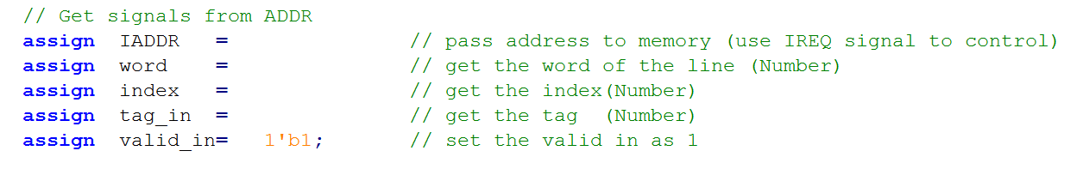
Part 1
This is a “Direct Mapped I-Cache” with 256 entries each has a 128 bits data.
ADDR [31:0] is a 32-bit signal (address) from CPU to Cache
First, you have to pass the ADDR to IADDR (send addr. to memory if cache miss)
The cache has 256 entries which means that your index should be ___ bits.
The cache has 4 data in each line (entry) which means that your word should be ___ bits.
Once you know how many bits index, word and tag_in need, use ADDR to complete the code
31
0
tag_in
index
word
00
請同學根據前面的內容決定 index, word, tag_in 分別需要幾個 bit，並且寫出三個訊號
分別來自ADDR當中的哪一段

Slide 56
Part 2
We have learned how to use index and tag to check if the cache access is a hit or miss. And we also learned how to setup the signal (IREQ) for main memory, and output data (DO) for CPU.
However, there are 4 words in each line (entry). We have to decide which word to output by a 2-bit signal called “word”, before sending data to CPU.
31
0
tag_in
index
word
00
127
64
63
32
31
0
data 4
data 3
data 2
data 1
128-bit
32-bit output

Slide 57
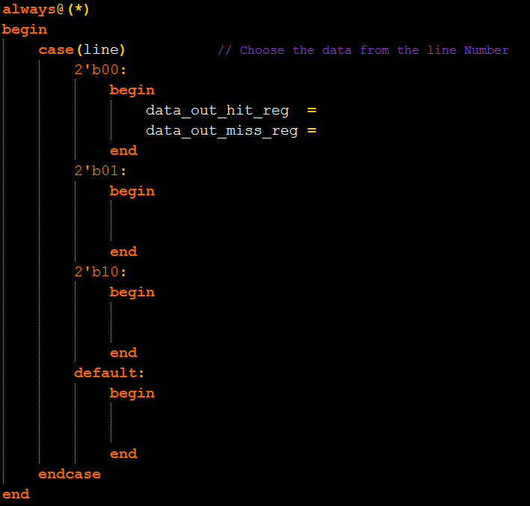
Part 2
data_out_hit_reg is a register which contains the data to output when cache hit
data_out is a 128-bit data which contains the data from cache
data_out_miss_reg is a register which contains the data for CPU when cache line refill completes.
data_in is a 128-bit data which contains the data from memory (assuming memory bus is 128 bits)
Put the 32-bit data into data_out_hit_reg from data_out
Put the 32-bit data into data_out_miss_reg from data_in

Slide 58
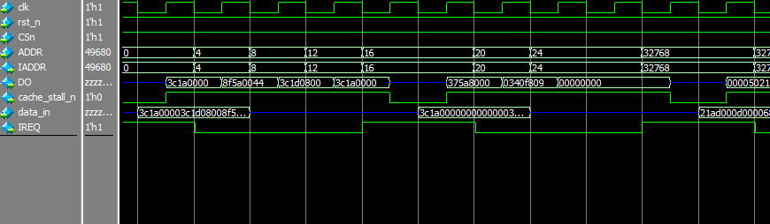
Verification
If your RTL code is correct, you will find that the cache misses every four different address.

Slide 59
挑戰題
In lab 6-2, we assume the bandwidth of the bus is 128-bit, which means that we can get 4 data (128-bit) from main memory at the same time when a cache miss happened.
128
CACHE
Main Memory

Slide 60
挑戰題
However, the real bus can send only one data ( 32-bit ) in each access to main memory. In this situation, the cache has to access main memory four times when encounter a cache miss. (assume each line has 4 data )
32
CACHE
Main Memory

Slide 61
挑戰題
The followings are the files we need in this part :
1. cpu_top.v 2. I_Cache.v 3. testbench.v
cpu_top.v
32
memory
I_Cache.v
testbench.v

Slide 62
挑戰題
And what we are going to do is :
Change the bandwidth in “I_Cache.v”, “cpu_top.v” and “testbench.v” from 128-bit ( [127:0] ) to 32-bit ( [31:0] ).
In “I_Cache.v”, whenever a cache access is miss, sends the address to main memory, waiting for the data from main memory.
Never send the data to CPU until the line refill is complete.

Slide 63
實驗結報
結報格式(每組一份)
封面
實驗內容(程式碼註解、結果截圖)
實驗心得
繳交位置
ftp : 140.116.164.227
帳號/密碼 : co2012
DeadLine:下次上課前
TA Contact Information:
助教信箱 : chen9611@gmail.com
Rm 92617
Office hour : (Tues)1300~1500、(Wed)1300~1400
63

